Slide 1
Perception and Performance on a Virtual Reality Cognitive Stimulation for Use in the Intensive Care Unit: A Non-randomized Trial in Critically Ill Patients
Frontiers in Medicine 2019
Impact factor：3.113

Slide 2
Introduction
1. The intensive care unit(ICU) is a noisy and stressful environment in which critically ill patients are exposed to psychological stress factors.
2. After ICU stay, ∼50–75% of all critically ill patients will suﬀer from newly acquired long-term cognitive impairment .
3. A study with 38 healthy participants shown the cognitive beneﬁts arising from the interaction with nature.
4. Attention Restoration Theory, states that attention, which inﬂuences cognitive performance, is a limited resource and can be depleted over a prolonged period of time.
5. Stress Recovery Theory, postulates that nature environments reduce fear and anger, and have a stimulating eﬀect on the parasympathetic nervous system(副交感神经系统) shown in physical markers of stress.

Slide 3
Introduction
6. There is currently no consensus on how to prevent cognitive impairments after ICU discharge.
7. The aim of this feasibility study in critically ill patients was to investigate the acceptance, comfort, recollection, visual perception and processing of immersive nature-related VR stimulation, and how VR aﬀects physiological parameters.
8. 3 hypotheses:
(1) VR stimulation oﬀers high usability, immersion and satisfaction, is recollected and does not promote discomfort.
(2) Patients would be able to perceive and process the VR stimulation before and during their stay in the ICU.
(3) VR stimulation will reduce physiological markers of stress.

Slide 4
Methods
1. 57 Participants
(1) Planned elective open-heart surgery (开胸手术)
(2) Age >18 years
(3) No neurological disorder
2. Three phases
(1) Pre-ICU session: 1 day prior to ICU admission.
(2) ICU session: the day after surgery.
(3) Follow-up session: ∼3 months after ICU discharge.

Slide 5
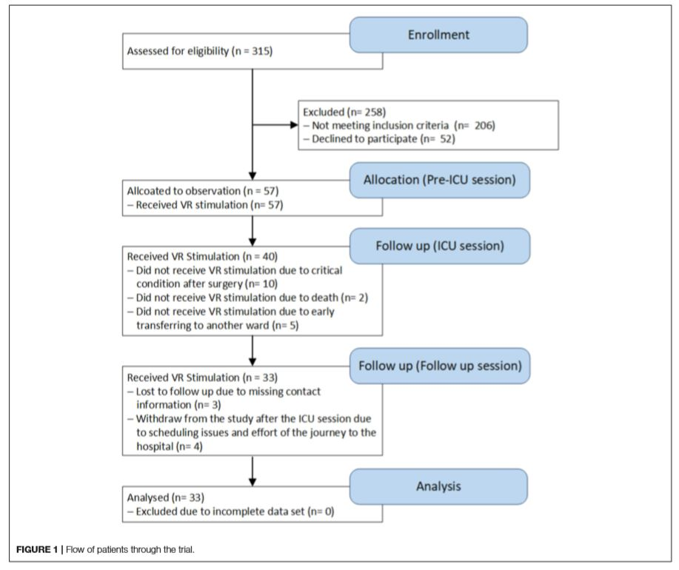

Slide 6
Methods
3. Cognitive VR Stimulation
(1) Hardware: a computer, HTC Vive, noise canceling headphones, equipment to measure the physiological parameters, a noise signal monitor (50 dB)
(2) A video presenting aquatic worlds and landscapes for 5 min.
(3) Classical music.

Slide 7
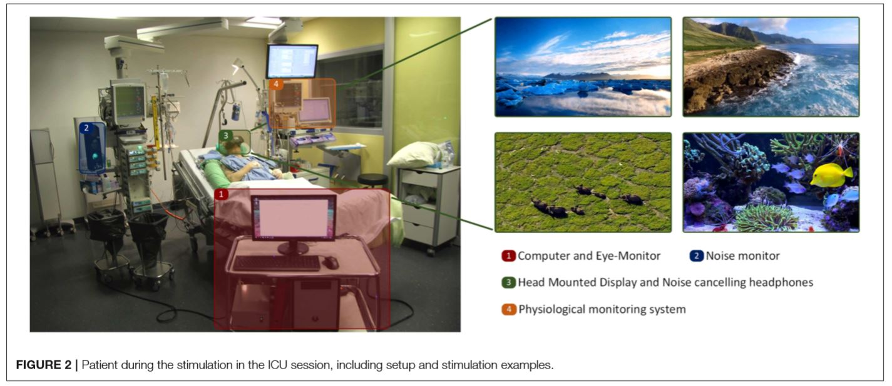

Slide 8
Methods
3. Outcomes
(1) Sedation level: Richmond Agitation-Sedation Scale(RASS)
(2) Consciousness: Glasgow Coma Scale(GCS)
(3) Delirium: Confusion Assessment Method for the Intensive Care Unit(CAM-ICU)
(4) Cognitive functions: Montreal-Cognitive-Assessment(MOCA)
(5) Health-related quality of life: The EuroQol group's 5-Domain 5-Level (EQ-5D-5L)
(6) Questionnaire on acceptance, discomfort and recollection

Slide 9
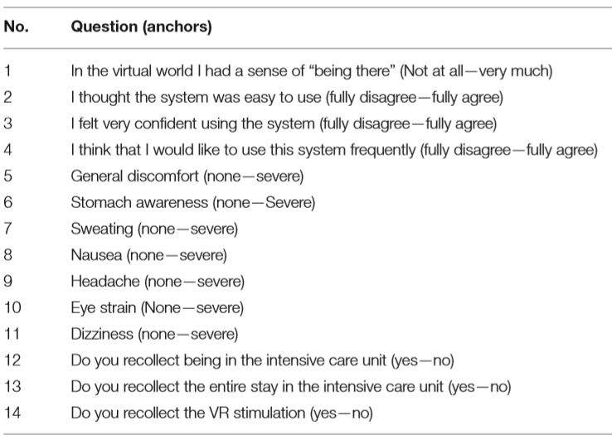

Slide 10
Methods
3. Outcomes
(7) Physiological parameters(ﬁrst 15s and the last 15s)
(a) Respiratory rate(呼吸频率)
(b) Blood pressure
(8) Eye movements
(a) The number of gazed moving objects
(b) Fixation duration
(c) Number of ﬁxations
(d) Time ﬁxating an object

Slide 11
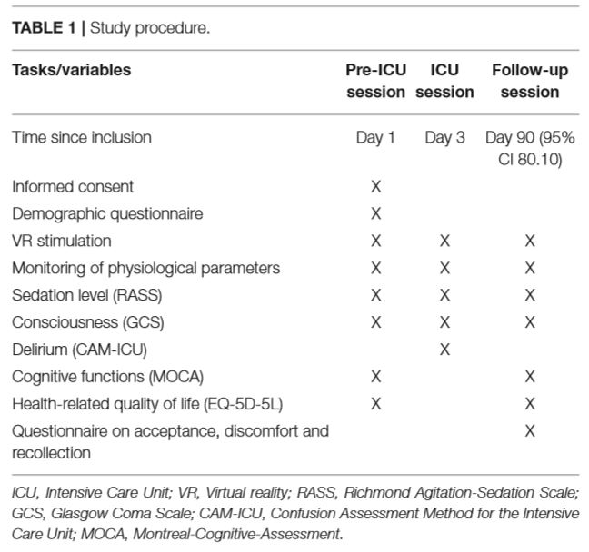
谵语

Slide 12
Results
1. Questionnaire ﬁndings revealed that the VR stimulation was well accepted, easy to use and appreciated by patients.
2. The number of gazed meaningful moving objects per minute was signiﬁcantly lower in the ICU session compared to the pre-ICU and follow-up sessions.
3. The respiratory rate decreased signiﬁcantly in all three sessions.

Slide 13
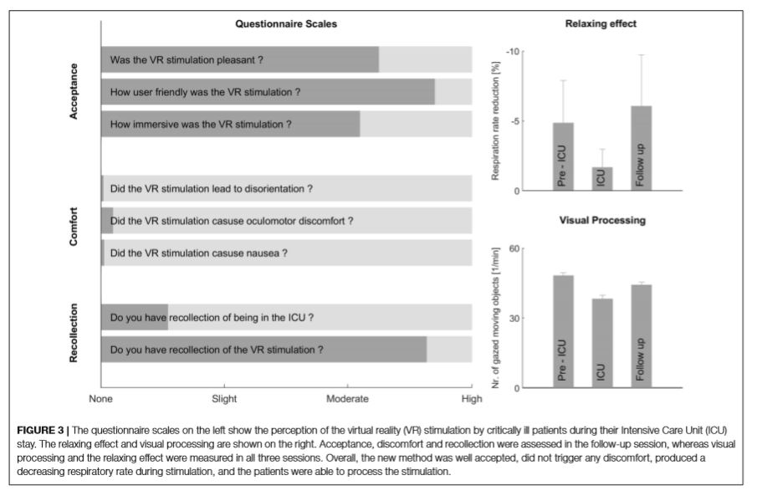

Slide 14
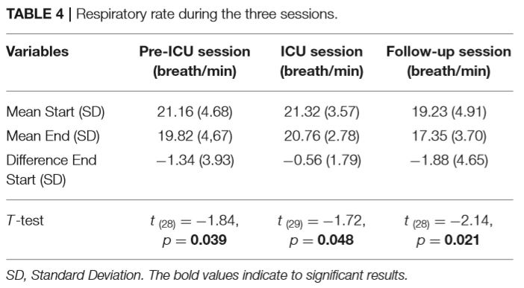

Slide 15
Results
4. Visual ﬁxation duration was signiﬁcantly higher in the ICU session compared to pre-ICU and follow-up sessions.
5. The number of ﬁxations were signiﬁcantly lower during the ICU session compared to pre-ICU and follow-up sessions.

Slide 16
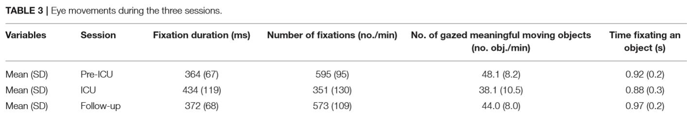

Slide 17
Conclusion
1. VR stimulation was pleasant, immersive, easy to use and did not promote discomfort.
2. Eye movement analysis indicated that critically ill patients were able to perceive and process the stimulation in all sessions.
3. VR stimulation decreased the respiratory rate to isolate and protect critically ill patients from the noisy and stressful environment.

Slide 18
后期计划
3.2~3.8. 测试、完成系统，并准备进行实验
3.9~3.15. 进行实验，完成论文Introduction部分
3.16~3.22. 进行实验，完成论文Introduction部分
3.23~3.29. 进行实验，完成论文Methods部分
3.30~4.5. 进行实验，完成论文Results部分
3.30~4.5. 完成论文

